Slide 1

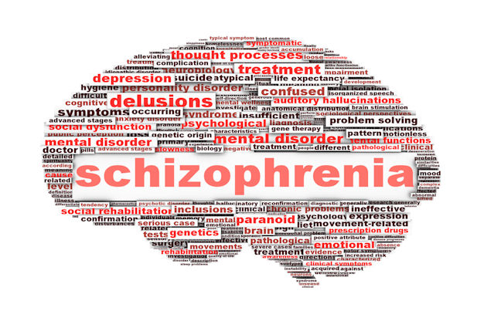
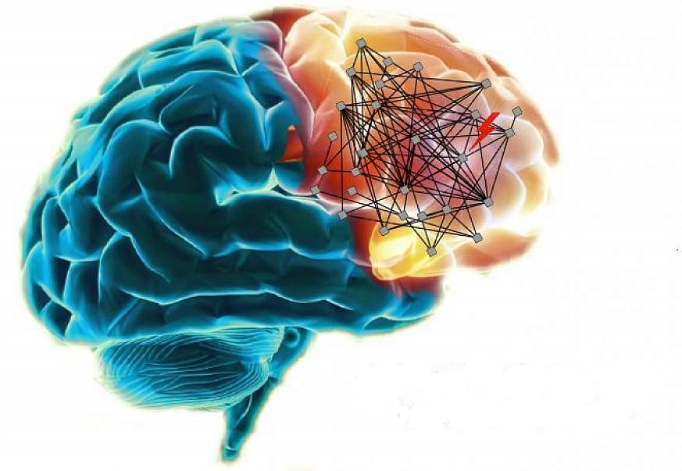
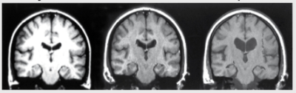
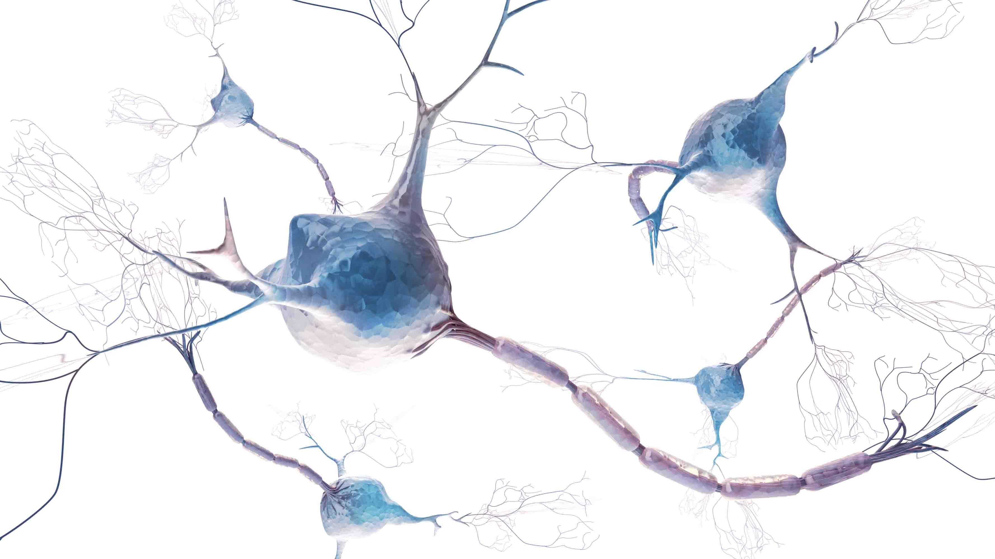

GENETICS OF SCHIZOPHRENIA
PALAK DASH, ARCHANA MISHRA & ROHIT SETH
GURU GHASIDAS VISHWAVIDYALAYA, KONI, BILASPUR,(C.G.)
About
SCHIZOPHRENIA
Schizophrenia is a chronic and severe mental disorder that affects how a person thinks, feels, and behaves. People with schizophrenia may seem like they have lost touch with reality. It is a psychiatric illness which often begins in the age from 16 to 30. In its active state patients undergo hallucinations and delusions and still in its inactive state patient undergoes depression and problems in their cognitive functions. Schizophrenia affects ~1% of the world population with a high heritability in the range of 64–81%
SYMPTOMS OF SCHIZOPHRENIA
Positive symptoms:
Hallucinations
Delusions
Thought disorders (unusual or dysfunctional ways of thinking)
Movement disorders (agitated body movements)
Negative symptoms:
“Flat affect” (reduced expression of emotions via facial expression or voice tone)
Reduced feelings of pleasure in everyday life
Difficulty beginning and sustaining activities
Reduced speaking
Cognitive symptoms:
Poor “executive functioning” (the ability to understand information and use it to make decisions)
Trouble focusing or paying attention
Problems with “working memory” (the ability to use information immediately after learning it)
CAUSES OF SCHIZOPHRENIA
Genetic and environmental factors, together are responsible for the signs of schizophrenia.
Though scientists have not yet got the specific reason for the cause of this disorder, still the till date discovery reveals that genes play a very crucial role in manipulation of the cognitive functions.
Environmental factors affecting schizophrenia may involve:
Exposure to viruses
Malnutrition before birth
Problems during birth
Psychosocial factors
Scientists think that an imbalance in the complex, interrelated chemical reactions of the brain involving the neurotransmitters (substances that brain cells use to communicate with each other) dopamine and glutamate, and possibly others, plays a role in schizophrenia.
GENETICS OF SCHIZOPHRENIA
Genome wide association studies (GWAS), proved that there are single nucleotide polymorphisms associated with schizophrenia located within or near to the miR137 host genes on chromosome.
miR137 (microRNA-137) is a very strongly associated schizophrenia risk loci.
microRNA-137 is known to regulate the
expression of ~1900 other genes, including
several that are independently associated
with schizophrenia.
SNPs act as markers for the cognitive functions associated with schizophrenia
The interaction between these genes create a multiple disorder symptom and they are inheritable too.
TREATMENTS
From the very early, antipsychotics were used to control the abnormal behaviours of patients.
Drugs like Clozapine were used, but due to its severe side effects as it causes agranulocytosis.
Asenapine and Iloperidone are antipsychotic treatments which do not cause agranulocytosis but have side effects like some metabolic syndromes.
Psycho-physiotherapy is also a kind of treatments which helps patient in their behavioural improvement
Doses as per recommended by the doctor is treatable and one should not leave the course in between.
FUTURE ASPECTS
Schizophrenia is a very serious mental disorder which persists lifetime and can cause a very serious mental abnormality if not treated.
These days scientists have discovered some of the SNPs which proves the cause of abnormalities, but the root cause is still unrevealed.
In the theory, it may be believed that due to manipulation in these genes a network of a biochemical pathways are disturbed due to which different cognitive functions are messed up including reduction in memory, concentration and IQ.
Schizophrenia is not curable but treatable, though scientists are looking forward to work on the genetic aspect of this disorder so as to control the heights of symptoms as far as possible.
No matter what it takes science is always on a path of getting the solution of all the questions and helping the society in one way or the other.
Forebrain is highly affected in SZ
MRI scans of the episodic periods of a SZ affected brain
Do not get confused between bipolar disorder and schizophrenia
Split mind: When you have many you within yourself, its schizophrenia.
In the book, “Straight talk with family and friends”, Meryllin Walsh uses the analogy of telephone switch board to explain SZ.
“In most people the brains switching system works well. In coming perception are send along appropriate signal paths, the switching process goes off without a hitch &appropriate feelings, thoughts &actions go back out again to the world”. “In the brain with SZ perceptions come in but get routed along the wrong path or get jammed, or end up at the wrong destination.”
- Meryllin Walsh

